Slide 1
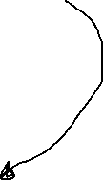
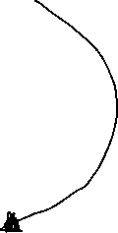
No Local Variables
Try_to_copy
source
•
8 bytes
dest
•
8 bytes
Y[3]
4.0
Y[3]
4.0
Y[2]
2.0
Y[2]
2.0
Y[1]
1.2
32 bytes
Y[1]
32 bytes
1.2
Y[0]
2.3
Y[0]
2.3
x[3]
?
x[3]
?
X[2]
?
X[2]
?
32 bytes
32 bytes
X[1]
?
X[1]
?
AR Main
X[0]
?
AR Main
X[0]
?
sum
0.0
8 bytes
sum
0.0
8 bytes
No Args
No Args

Slide 2
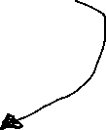
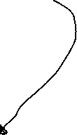
No Local Variables
No Local Variables
Try_to_change
add_them
dest
•
8 bytes
Arg
•
8 bytes
Y[0]
2.3
Y[3]
4.0
Y[1]
2.0
Y[2]
Y[2]
2.0
1.2
32 bytes
Y[1]
Y[3]
-8.25
32 bytes
4.0
Y[0]
2.3
X[0]
?
x[3]
49.0
X[1]
?
32 bytes
X[2]
?
32 bytes
X[2]
?
X[1]
?
AR Main
x[3]
49.0
X[0]
AR Main
?
sum
0.0
sum
0.0
No Args
8 bytes
No Args
8 bytes

